Slide 1
Introduction to Data Analytics MCA-3282 Open Elective – 6th sem B.Tech Topic - Grouping
Rohini R. Rao
Dept of Computer Applications
Jan 2020
(Slide set 3 out of 5)

Slide 2
Contents
Introduction to grouping
Clustering
Categories of clustering algorithms
Distance measures
K-means clustering
Agglomerative clustering
Frequent Patterns
Associative Rules
Measures of Pattern Interestingness
Apriori
Types of Association Rules
Case Studies
Case study 3 : Crime & Hot spot analysis
Case study 4: Amazon – recommender systems
References

Slide 3
Steps in data analysis projects
Problem Definition
Objectives
Data Preparation
Implementation of the Analysis
Summarizing the data
Deployment
Plan and execute deployment based on the definition in step 1
Deliverables
Roles and responsibilities
Current situation
Timeline
Costs and benefits
Pull together data table
Categorize the data
Clean the data
Remove unnecessary data
Transform the data
Partition the data
Finding hidden relationships
Making prediction
Review the project
Measure and monitor performance

Slide 4
Grouping
Dividing a data set into smaller subsets of related observations or groups
Reasons include
Finding hidden relationships
Becoming familiar with the data
Segmentation
Grouping Approaches
Supervised versus unsupervised
Type of variables
Data set size limit
Interpretable and actionable
Overlapping groups
Simplest grouping method – Grouping by values or range
Query 1: All cars where Horsepower is greater than or equal to 160 AND Weight is greater than or equal to 4000.

Slide 5
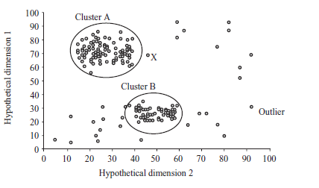
Clustering
A good clustering method will produce high quality clusters with
high intra-class similarity
low inter-class similarity
Unsupervised learning
Clustering Methods include
Partitioning
Hierarchical
Others - Density based, grid based, model based etc.

Slide 6
Categorization of Major Clustering Methods
Partitioning methods
Given D , a data set of n objects and k, the number of clusters to form
Partition algorithm organizes the objects into k partitions where each partition represents a cluster.
Centroid Based Technique
k_Means Method
k-Medoids Method
Popular techniques include PAM , CLARA , CLARANS
Hierarchical methods
Creates hierarchical decomposition of the given set of data objects
Agglomerative or bottom-up approach
Divisive or top-down approach
Popular techniques include CHAMELEON and BIRCH

Slide 7
Categorization of Major Clustering Methods
Density-based methods
results in non-spherical shaped clusters also
Instead continue growing the given cluster as long as the density in the neighborhood exceeds some threshold
Popular techniques include DBSCAN , DENCLUE and OPTICS
Grid-based methods
Quantize the object space into a finite number of cells that form a grid structure.
All clustering performed on the grid structure
Fast processing time
Popular techniques include STING and WAVECLUSTER
Model-based methods
Hypothesize a model for each of the cluster and find the best fit of the data to the given model
Popular techniques include EM, COBWEB and SOM

Slide 8
K-Means Clustering
Choose the number of clusters, k.
Randomly generate k clusters and determine the cluster centers, or directly generate k random points as cluster centers.
Assign each point to the nearest cluster center.
Recompute the new cluster centers.
Repeat the two previous steps until some convergence criterion is met (usually that the assignment hasn't changed).
Example: The data set has three dimensions and the cluster has two points: X = (x1, x2, x3) and Y = (y1, y2, y3). Then the centroid Z becomes Z = (z1, z2, z3), where z1 = (x1 + y1)/2 and z2 = (x2 + y2)/2 and z3 = (x3 + y3)/2.
Within cluster variation - Square-error criterion E = ∑ _{i=1}^{k} ∑_{p ЄCi}│p - m_{i}│²
Advantages:
Simplicity and speed
Disadvantages :
Does not yield the same result with each run, since the resulting clusters depend on the initial random assignments.
Sensitive to outliers

Slide 9
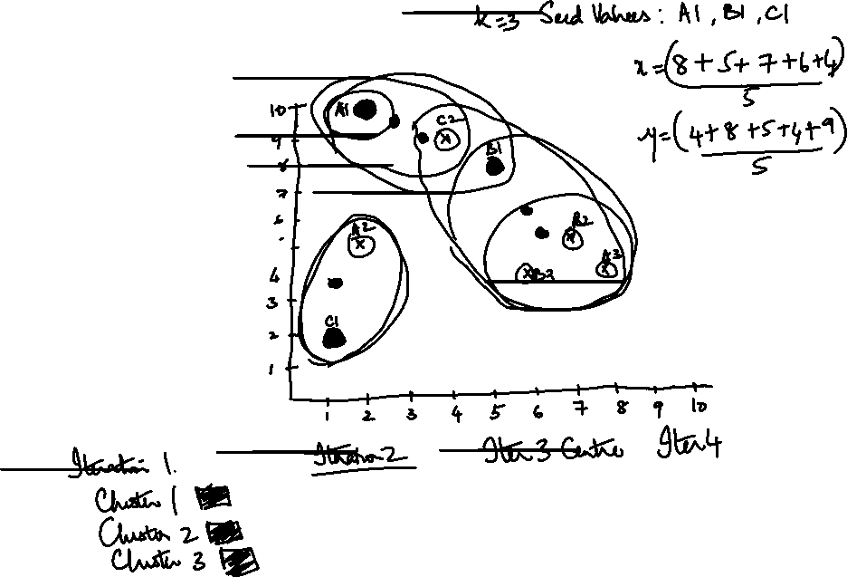
K-Means Clustering
A1 | (2,10)
A2 | (2,5)
A3 | (8,4)
B1 | (5,8)
B2 | (7,5)
B3 | (6,4)
C1 | (1,2)
C2 | (4,9)

Slide 10
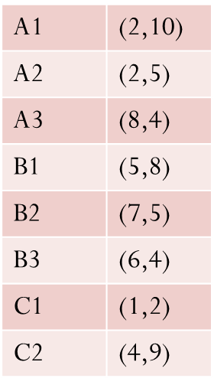
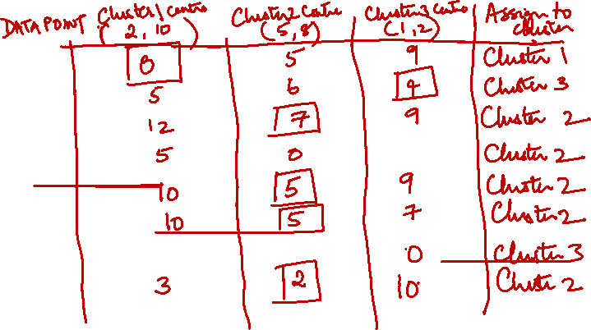
K-Means Clustering – Distance Matrix

Slide 11
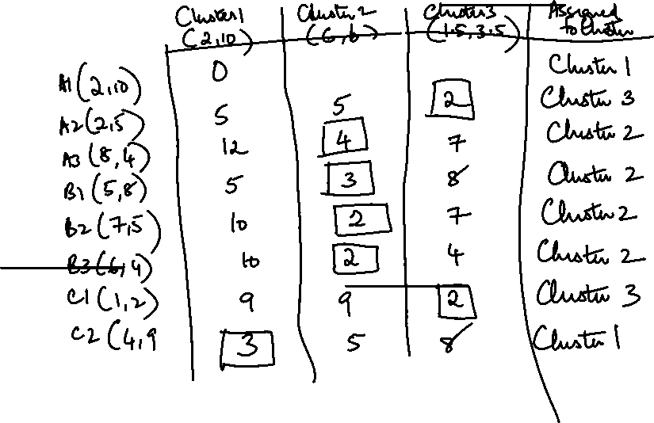
K-Means Clustering – Iteration 2

Slide 12
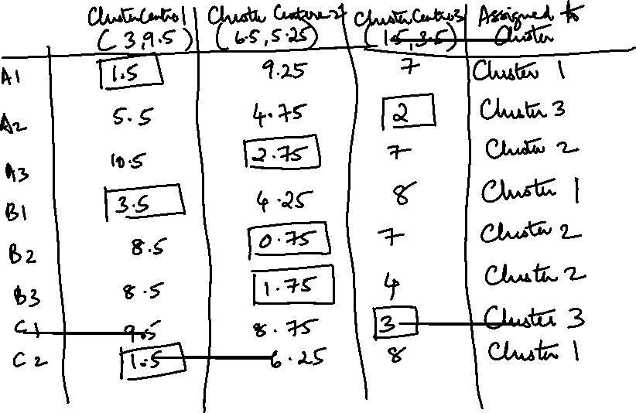
K-Means Clustering – Iteration 3

Slide 13
Cluster quality measures
Within cluster variation - Square-error criterion
E = ∑ _{i=1}^{k} ∑_{p ЄCi}│p - m_{i}│²

Slide 14
Hierarchical Clustering
Works by grouping data objects into a tree of clusters
Can be classified depending on whether decomposition is
Agglomerative -bottom-up or Merging
Divisive – top down or Splitting
Quality of clusters not good because once merge or split decision is made – no back tracking
normally limited to small data sets (often less than 10,000 observations)
speed to generate the hierarchical tree can be slow for higher numbers of observations

Slide 15
Agglomerative Clustering
Given a set of N items to be clustered, and an NxN distance (or similarity) matrix, the basic process hierarchical clustering is this:
1.Start by assigning each item to its own cluster, so that if you have N items, you now have N clusters, each containing just one item. Let the distances (similarities) between the clusters equal the distances (similarities) between the items they contain.
2.Find the closest (most similar) pair of clusters and merge them into a single cluster, so that now you have one less cluster.
3.Compute distances (similarities) between the new cluster and each of the old clusters.
4.Repeat steps 2 and 3 until all items are clustered into a single cluster of size N or until certain termination condition.
Terminating condition : desired number of clusters or the diameter of each cluster is within a certain threshold.
Merging Criterion – Single Linkage Approach - Cluster C1 & C2 are merged if any object in C1 and any object in C2 form a minimum euclidean distance between any two objects from different clusters

Slide 16
Hierarchical Clustering
These method does not require the number of clusters k as an input, but needs a termination condition
AGNES – Agglomerative Nesting
DIANA – Divisive Analysis
Step 0
Step 1
Step 2
Step 3
Step 4
agglomerative
(AGNES)
a
a b
b
a b c d e
c
c d e
d
d e
e
divisive
(DIANA)
Step 4
Step 3
Step 2
Step 1
Step 0

Slide 17
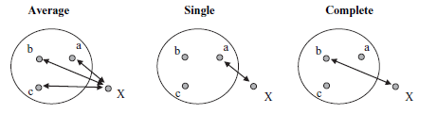
Computing Distances
Single-link clustering
Consider the distance between one cluster and another cluster to be equal to the shortest distance from any member of one cluster to any member of the other cluster.
Complete-link clustering
Consider the distance between one cluster and another cluster to be equal to the longest distance from any member of one cluster to any member of the other cluster.
Average-link clustering :
Consider the distance between one cluster and another cluster to be equal to the average distance from any member of one cluster to any member of the other cluster.

Slide 18
Example- Agglomerative with single link
 | A | B | C | D | E | F
A | 0 | 1 | 5 | 9 | 10 | 2
B | 1 | 0 | 3.5 | 8 | 7 | 5.5
C | 5 | 3.5 | 0 | 3 | 4 | 6.5
D | 9 | 8 | 3 | 0 | 0.5 | 4.5
E | 10 | 7 | 4 | 0.5 | 0 | 2.5
F | 2 | 5.5 | 6.5 | 4.5 | 2.5 | 0

Slide 22
A Dendrogram Shows How the Clusters are Merged Hierarchically
Decompose data objects into a several levels of nested partitioning (tree of clusters), called a dendrogram.
A clustering of the data objects is obtained by cutting the dendrogram at the desired level, then each connected component forms a cluster.

Slide 23
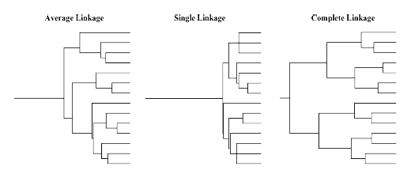
Clustering under different linkage rules

Slide 24
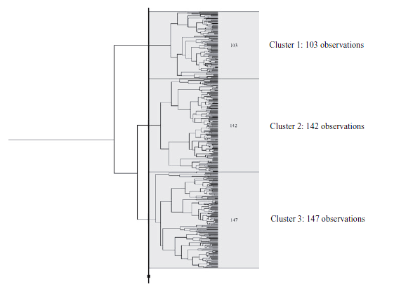
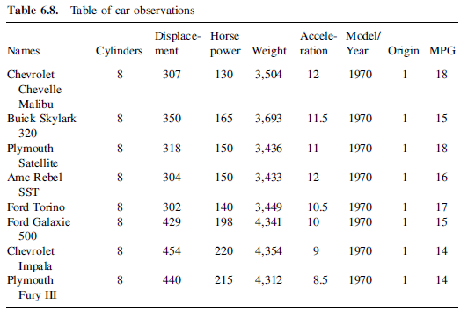
392 cars – Agglomerative clustering Euclidean distance & average linkage

Slide 25
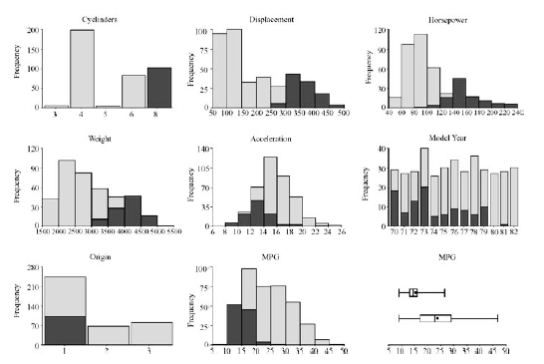
Result - Summary of Cluster 1

Slide 26
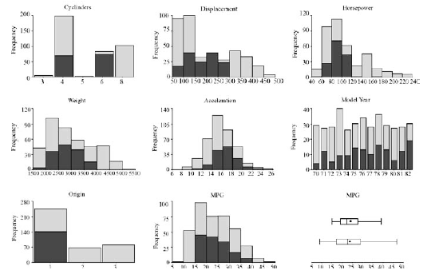
Result - Summary of Cluster 2

Slide 27
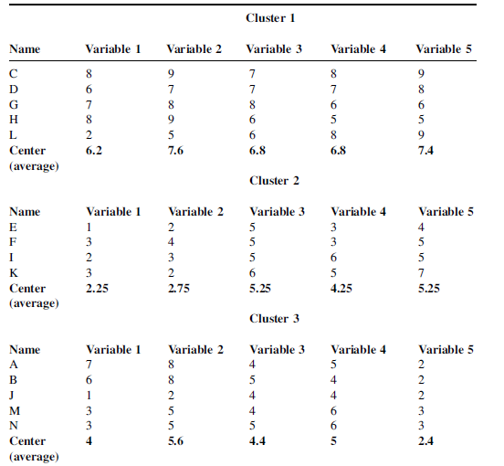
Clustering the same data set using k-means clustering Euclidean distance

Slide 28
Density-Based Clustering Methods
Clustering based on density (local cluster criterion), such as density-connected points
Major features:
Discover clusters of arbitrary shape
Handle noise
One scan
Need density parameters as termination condition
Several interesting studies:
DBSCAN: Ester, et al. (KDD’96)
OPTICS: Ankerst, et al (SIGMOD’99).
DENCLUE: Hinneburg & D. Keim (KDD’98)
CLIQUE: Agrawal, et al. (SIGMOD’98)

Slide 29
DBSCAN: Density Based Spatial Clustering of Applications with Noise
Relies on a density-based notion of cluster: A cluster is defined as a maximal set of density-connected points
Discovers clusters of arbitrary shape in spatial databases with noise
Outlier
Border
Eps = 1cm
MinPts = 5
Core

Slide 30
DBSCAN: The Algorithm
Arbitrary select a point p
Retrieve all points density-reachable from p wrt Eps and MinPts.
If p is a core point, a cluster is formed.
If p is a border point, no points are density-reachable from p and DBSCAN visits the next point of the database.
Continue the process until all of the points have been processed.

Slide 31
Case study 3- Crime & Hot spot analysis
Crime hot spots is an area where the number of criminal events or disorder is higher than in any other places particular environments that attract drug trading and crimes in larger-than-expected concentrations, so-called crime generators
Hot spots defined by attributes such as
Location – latitude & longitude
particular activities such as drug trading, use of firearms , weapons
specific concentrations of land uses- hotels , bars
interactions between activities and land uses, such as thefts at transit stations or bus stops
Techniques that can be used
Partitioning method – k-mode clustering
Density based method – Single Kernel Density method
Interpretation of clusters
The area of highest crime rate is where many shops, banks and people hang out.
Another cluster is the neighborhood of the city, where residents have a high purchasing power
the number of crimes using firearms was very large
Case study

Slide 32
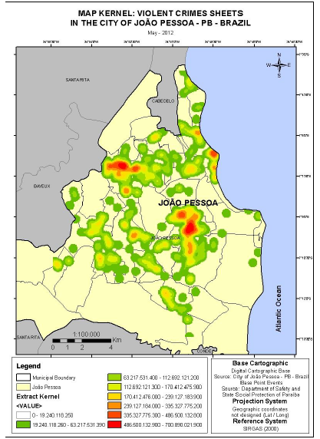
Crime & Hot spot analysis

Slide 33
Frequent Patterns
Types of Patterns include
Temporal Patterns
Spatial Patterns
Functional Patterns
Frequent pattern mining searches for recurring relationships in a given sets.
Frequent Patterns
Are patterns that appear in the data set frequently
A subsequence that appears frequently is a frequent sequential pattern
If a sub structure occurs frequently it is called a frequent structured pattern

Slide 34
Frequent Patterns

Slide 35
Market Basket Analysis
Analyzes customer buying habits by finding associations between different items that customers place in their shopping baskets
Leads to the discovery of associations and correlations among items in large transactional or relational data sets.
“Which groups or sets of items are customers likely to purchase on a given trip to the store ?”
Helps in business decision making process, such as
catalog design,
cross-marketing
customer shopping behavior analysis.
Can be used to plan different store layouts.
Place them together
Place them far apart
Decide which item to put on sale.
Patterns can be represented in the form of Association rules

Slide 36
Association Rules
Marketing and Sales Promotion:
Let the rule discovered be
{Bagels, … } ⇒ {Potato Chips}
Potato Chips as consequent => Can be used to determine what should be done to boost its sales.
Bagels in the antecedent => Can be used to see which products would be affected if the store discontinues selling bagels.
Bagels in antecedent and Potato chips in consequent => Can be used to see what products should be sold with Bagels to promote sale of Potato chips!

Slide 37
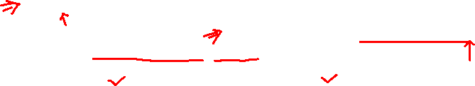
Associative Rules
Each item has a boolean variable representing the presence or absence of that item.
Each basket can be represented by a Boolean vector of values assigned to these variables.
These patterns are then represented as a Boolean Association Rule
buys(X,”computer”) =>buys(X,”antivirus_software “)
[support = 2%, confidence = 60 % ]
Measures of pattern interestingness can be
Subjective – useful, previously unknown
Objective
Support of 2 % of all transactions have computers and anti virus software purchased together
Confidence of 60 % means that 60 % of all customers who purchased a computer also bought the software.
Minimum support and confidence set by domain expert

Slide 38
Association Rule Mining
Steps involved
Find all frequent items sets – each of these item sets will occur at least as frequently as a pre determined minimum support count
Generate strong association rules from the frequent item sets – rules should satisfy minimum support and confidence.
Association rules can be generated as follows
For each frequent itemset l, generate all nonempty subsets of l
For every nonempty subset s of l , output the rule s=> (l-s)
If support_count(l)/support_count(s) >= min_conf
Where min_conf is the minimum confidence threshold

Slide 39
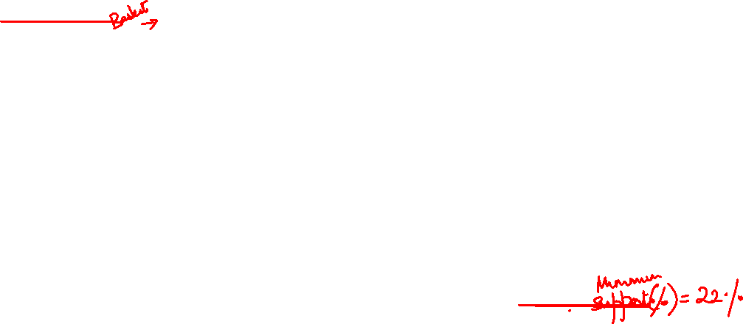

Example 1 – Apriori
Transaction
T100 | I1 | I2 | I5
T200 | I2 | I4
T300 | I2 | I3
T400 | I1 | I2 | I4
T500 | I1 | I3
T600 | I2 | I3
T700 | I1 | I3
T800 | I1 | I2 | I3 | I5
T900 | I1 | I2 | I3
Find all frequent itemsets with minimum support count of 2 .
Find all association rules with minimum confidence of 70%

Slide 40
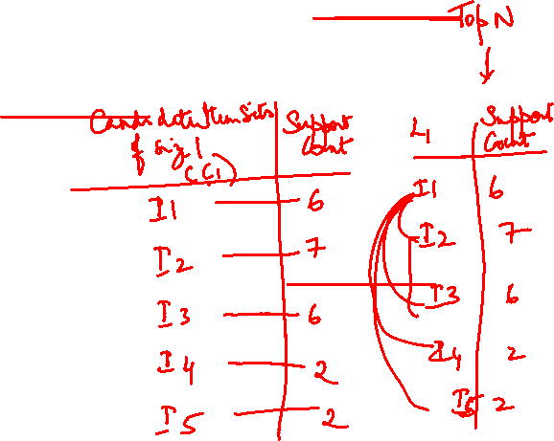

Example 1 – Apriori – Iteration 1
Transaction
T100 | I1 | I2 | I5
T200 | I2 | I4
T300 | I2 | I3
T400 | I1 | I2 | I4
T500 | I1 | I3
T600 | I2 | I3
T700 | I1 | I3
T800 | I1 | I2 | I3 | I5
T900 | I1 | I2 | I3

Slide 41
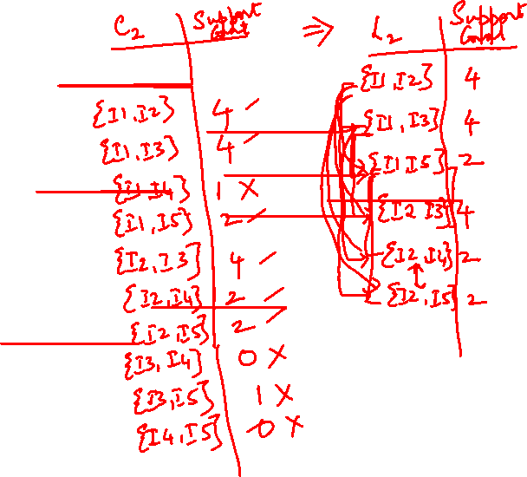

Example 1 – Apriori Iteration 2
Transaction
T100 | I1 | I2 | I5
T200 | I2 | I4
T300 | I2 | I3
T400 | I1 | I2 | I4
T500 | I1 | I3
T600 | I2 | I3
T700 | I1 | I3
T800 | I1 | I2 | I3 | I5
T900 | I1 | I2 | I3

Slide 42
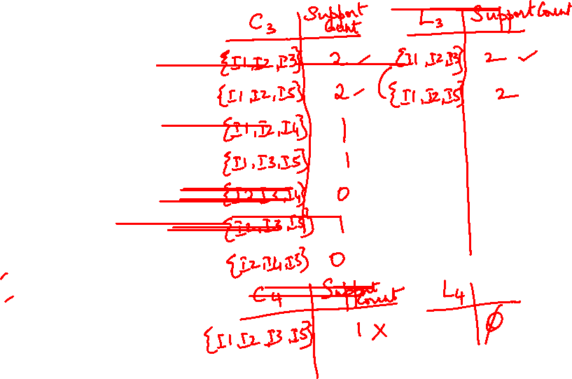
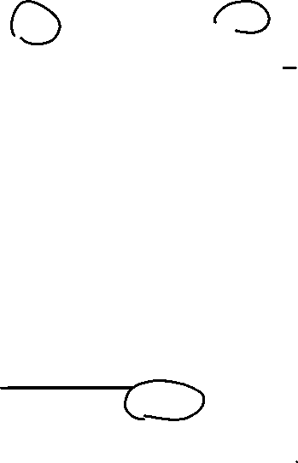
Example 1 – Apriori Iteration 3
Transaction
T100 | I1 | I2 | I5
T200 | I2 | I4
T300 | I2 | I3
T400 | I1 | I2 | I4
T500 | I1 | I3
T600 | I2 | I3
T700 | I1 | I3
T800 | I1 | I2 | I3 | I5
T900 | I1 | I2 | I3

Slide 43
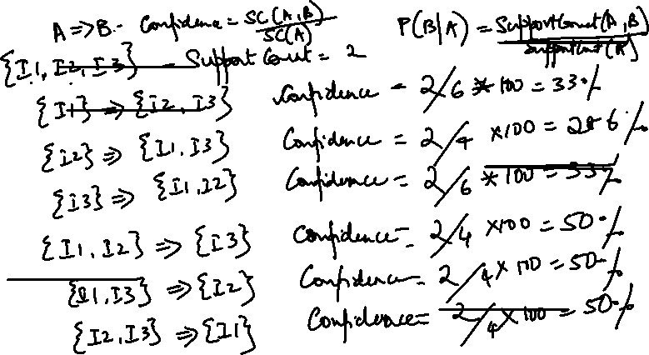
Example 1 – Apriori – Association Rules

Slide 44
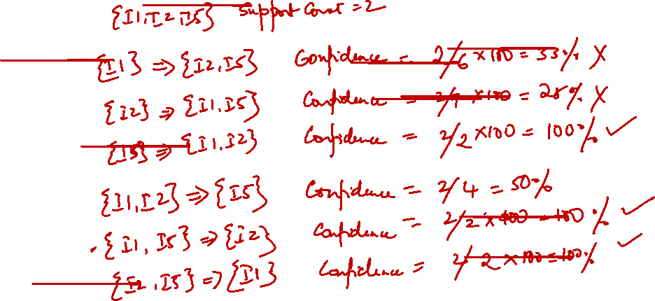
Example 1 – Apriori – Association Rules

Slide 45
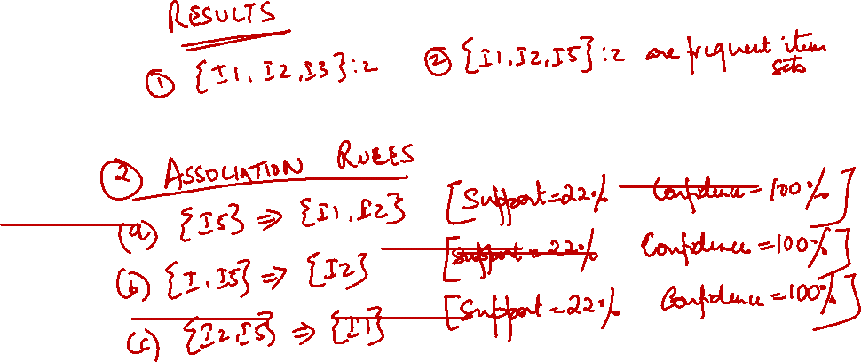

Slide 46
Apriori Algorithm
Seminal algorithm proposed by R. Agarwal and R.Srikant in 1994 for mining frequent itemsets for Boolean association rules.
Employs an iterative , bottom-up approach known as level-wise search , where k-itemsets are used to explore (k+1) itemsets
Based on Apriori property :
All nonempty subsets of a frequent itemset must also be frequent
Antimonotone – if a set cannot pass a test then all its supersets will fail the same test as well
Two step process of the Apriori algorithm are
Join Step
To find L_{k} , a set of candidate k-itemsets is generated by joining L_{k-1} with itself. This set of candidates is denoted C_{k}
Prune Step
C_{k} is the superset of L_{k}, its members may or may not be frequent but all of the frequent k-itemsets are included in C_{k}
A scan of the database to determine the count of each candidate in C_{k} will result in L_{k}
To reduce the size of C_{k} the apriori property is used . Any (k-1) itemset that is not frequent cannot be a subset of a frequent k-itemset.

Slide 47
Frequent Item sets
Let T = { I₁,I₂ , I₃ ….I_{m}} be a set of items
Each transaction has a T_id
An association is an implication of the form
A=> B where A C T , B C T and A Π B = Ø
Support (A => B) = P ( A U B)
Confidence( A => B) = P ( B/A)
A set of items is called as an item set
The set { computer , anti_virus} is called 2 item set
The occurrence frequency of an item set is the number of transactions that contain the item set.
This is also known as frequency , support count or count of the item set.
Confidence(A=> B) = P ( B/A) = support (A U B ) / support (A)
A ⇒ B, A,B – Set of items.
Support : Count (A U B )
Confidence : support Count (A U B )
support Count (A)

Slide 48
Pros & Cons of Apriori
Characteristics of Apriori Algorithm:
Simple, user friendly algorithm
No. of database scans = k, if (k-1)-large item sets are possible
Discovers all possible large item sets
Robust algorithm
Ranking of rules required
Disadvantages of Apriori Algorithm
In general a data set that contains k items can potentially generate up to 2^{K} – 1 frequent item sets
Generation of candidate item sets is expensive (in both space and time)
Support counting is expensive
Subset checking (computationally expensive)
Multiple Database scans (I/O)

Slide 49
Improving the efficiency of Apriori
Hash-based technique-
- While scanning data base for 1-itemsets L₁ generate all of the n+1 item sets for each transaction
- Hash ie. map into different buckets of a hash table and increase the bucket count.
- If the bucket count is below support threshold remove from the candidate set.
Transaction reduction
transaction that does not contain any frequent k-item sets cannot contain frequent (k+1) item sets.
Remove such transactions or mark them.
Partitioning
Transactions in D are divided into n partitions
Phase 1 : Find the frequent item sets local to each partition
Phase 1 : Combine all local Frequent Item sets to form candidate item set.
Phase 2 : Find global frequent item sets among the candidates
Phase 2 : Frequent item sets in D
Sampling
Search for frequent item sets in S of a given data D
Trade off between accuracy and efficiency
Lower support thresholds
Dynamic Item set Counting
New candidate item sets can be added at any start point unlike Apriori which determines new candidate item sets only immediately before each complete database scan

Slide 50
Partition Algorithm
Partitions the set of transactions into smaller segments so that they can be accommodated in memory.
Does only two scans of database
Phase 1
generates n non overlapping partitions of dataset
1st scan generates a set of all potential frequent itemsets
Applies local support.
Phase 2 – Superset of frequent items used to generate actual support count
2nd scan counts actual support
Theory is that phase 1 frequent item sets can contain false positives, no false negatives

Slide 52
Example 2 – Apriori –
Transaction | A1 | A2 | A3 | A4 | A5 | A6 | A7 | A8 | A9
1 | 1 | 0 | 0 | 0 | 1 | 1 | 0 | 1 | 0
2 | 0 | 1 | 0 | 1 | 0 | 0 | 0 | 1 | 0
3 | 0 | 0 | 0 | 1 | 1 | 0 | 1 | 0 | 0
4 | 0 | 1 | 1 | 0 | 0 | 0 | 0 | 0 | 0
5 | 0 | 0 | 0 | 0 | 1 | 1 | 1 | 0 | 0
6 | 0 | 1 | 1 | 1 | 0 | 0 | 0 | 0 | 0
7 | 0 | 1 | 0 | 0 | 0 | 1 | 1 | 0 | 1
8 | 0 | 0 | 0 | 0 | 1 | 0 | 0 | 0 | 0
9 | 0 | 0 | 0 | 0 | 0 | 0 | 0 | 1 | 0
10 | 0 | 0 | 1 | 0 | 1 | 0 | 1 | 0 | 0
11 | 0 | 0 | 1 | 0 | 1 | 0 | 1 | 0 | 0
12 | 0 | 0 | 0 | 0 | 1 | 1 | 0 | 1 | 0
13 | 0 | 1 | 0 | 1 | 0 | 1 | 1 | 0 | 0
14 | 1 | 0 | 1 | 0 | 1 | 0 | 1 | 0 | 0
15 | 0 | 1 | 1 | 0 | 0 | 0 | 0 | 0 | 1

Slide 53
Example 2 - Apriori
L1
ItemSet | Support Count
A2 | 6
A3 | 6
A4 | 4
A5 | 8
A6 | 5
A7 | 7
A8 | 4

Slide 54
Example 2- Apriori
C3
ItemSet | Support Count
{A2,A3,A4} | 1
{A2,A3,A5} | 0
{A2,A3,A7} | 0
{A3,A5,A7} | 3
{A3,A5,A6} | 0
{A3,A6,A7} | 0
{A5,A6,A7} | 1

Slide 55
Example 2 - Apriori
Association Rules – Frequent Itemset{A3,A5,A7}

Slide 56
Example 2 – Partitioning Algorithm
Transaction | A1 | A2 | A3 | A4 | A5 | A6 | A7 | A8 | A9
1 | 1 | 0 | 0 | 0 | 1 | 1 | 0 | 1 | 0
2 | 0 | 1 | 0 | 1 | 0 | 0 | 0 | 1 | 0
3 | 0 | 0 | 0 | 1 | 1 | 0 | 1 | 0 | 0
4 | 0 | 1 | 1 | 0 | 0 | 0 | 0 | 0 | 0
5 | 0 | 0 | 0 | 0 | 1 | 1 | 1 | 0 | 0
6 | 0 | 1 | 1 | 1 | 0 | 0 | 0 | 0 | 0
7 | 0 | 1 | 0 | 0 | 0 | 1 | 1 | 0 | 1
8 | 0 | 0 | 0 | 0 | 1 | 0 | 0 | 0 | 0
9 | 0 | 0 | 0 | 0 | 0 | 0 | 0 | 1 | 0
10 | 0 | 0 | 1 | 0 | 1 | 0 | 1 | 0 | 0
11 | 0 | 0 | 1 | 0 | 1 | 0 | 1 | 0 | 0
12 | 0 | 0 | 0 | 0 | 1 | 1 | 0 | 1 | 0
13 | 0 | 1 | 0 | 1 | 0 | 1 | 1 | 0 | 0
14 | 1 | 0 | 1 | 0 | 1 | 0 | 1 | 0 | 0
15 | 0 | 1 | 1 | 0 | 0 | 0 | 0 | 0 | 1

Slide 57
Example 2 – Partitioning Algorithm

Slide 58
Types of patterns mined
Multilevel Association rules
buys(X,”computer”) => buys(X,”HP-printer”)
buys(X,”lap-top-computer”) => buys(X,”HP-printer”)
Multidimensional Association rules
age(X,”30..39”) П income(X,”42K..48K”) => buys(X,”high resolution TV)
Association rules or correlation rules
Strong Gradient relationships – “The average sales from Sony digital camera increases over 16 % when sold together with Sony laptop”
Sequential Pattern Mining
which searches for frequent subsequences in a sequence data set.
Ex : customer first buys PC followed by digital camera and then memory card.
Structured Pattern Mining which looks for frequent substructures
Recommender systems
which recommend information items (e.g., books, movies, web pages) that are likely to be of interest to the user based on similar users’ patterns.

Slide 59
From Association Mining to Correlation Analysis
Suppose that 10,000 transactions are analysed, 6000 include computer games, 7500 include videos, 4000 included both games and videos.
Suppose there is an association rule
buys(X,”computer games”) => buys(X,”videos”)
[ support = 40 % , confidence = 66 % ]
Rule is misleading because the probability of purchasing videos is 75% which is even larger than 66 %
Actually computer games and videos could be negatively associated
Confidence which is conditional probability does not measure strength of the correlation and implications between antecendent and consequent.
Even strong association rules can be uninteresting and misleading.
So support-confidence framework needs be supplemented.

Slide 60
Correlation rules
A => B [support, confidence, correlation]
The occurrence of itemset A is independent of the occurrence of itemset B if P(AUB) = P(A)P(B) otherwise itemsets A and B are dependent and correlated as events.
Lift :
between the occurrence of A and B can be measured by computing
Lift(A,B) = P(AUB)/P(A)P(B)
Also written as Lift(A,B) = conf(A=>B)/ supp(B)
If the resulting value
<1 then the occurrence of A is negatively correlated with occurrence of B
>1 then A and B are positively correlated
=1 then A and B are independent and there is no correlation between them.
Ex: P({game,video})/P({game}) * P({video}) = 0.40 / (0.60 * 0.75) = 0.89
Because it is less than 1 video and game are negatively correlated

Slide 61
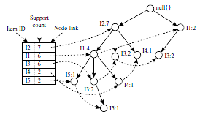
Other important Algorithms
Frequent Pattern Growth Algorithm
Allows frequent item set discovery without candidate item set generation.
Two step approach:
Step 1: Build a compact data structure called the FP-tree, built using 2 passes over the data-set.
Step 2: Extracts frequent items ets directly from the FP-tree by traversal through FP-Tree
Advantages of FP-Growth
only 2 passes over data-set
no candidate generation
much faster than Apriori
Disadvantages of FP-Growth
FP-Tree may not fit in memory!!
FP-Tree is expensive to build

Slide 62
Example 1 – FP Growth
Transaction
T100 | I1 | I2 | I5
T200 | I2 | I4
T300 | I2 | I3
T400 | I1 | I2 | I4
T500 | I1 | I3
T600 | I2 | I3
T700 | I1 | I3
T800 | I1 | I2 | I3 | I5
T900 | I1 | I2 | I3
Find all frequent itemsets with minimum support count of 2 .
Find all association rules with minimum confidence of 70%

Slide 63
Example 1 – FP Growth Tree Construction

Slide 64
Example 1- Mining the FP growth tree

Slide 65
Example 1- Mining the FP growth tree

Slide 66
Associative rules
Advantages:
Easy to interpret: The results are presented in the form of a rule that is easily understood.
Actionable: It is possible to perform some sort of action based on the rule.
Large data sets: It is possible to use this technique with large numbers of observations.
Limitations :
Only categorical variables: or to convert continuous variable to categorical variables.
Time-consuming: There are ways to make the analysis run faster but they often compromise the final results.
Rule prioritization: The method can generate many rules that must be prioritized and interpreted.

Slide 67
Summary measures of pattern interestingness

Slide 68
Goal of Recommender Systems
Personalization of shopping experience
Considers a set, C, of users and a set, S, of items.
u is a utility function that measures the usefulness of an item, s, to a user, c.
The utility is represented by a rating and is initially defined only for items previously rated by users.
False positive are irritation to customer
false negative is loss of revenue

Slide 69
Collaborative Filtering
Association rules don’t take into consideration, the preference or rating given by the customer
Collaborative Filtering
Take into consideration, what customers bought and how they rated them
Approaches are
Content-based approach or Item based similarity
recommends items that are similar to items the user preferred or queried in the past.
Collaborative approach or User based similarity
consider a user’s social environment.
It recommends items based on the opinions of other customers who have similar tastes or preferences as the user.

Slide 70
Collaborative Filtering
Notion of Similarity
If A and B have purchased same products and rated them similarly on common similar scale
Implication
If A has bought a new product and/or rated high recommend the product to B
Cold start problem

Slide 71
Distance Measures for numeric attributes
Euclidean Distance
X₁ = ( x₁₁,x₁₂,…x_{1n}) and X₂ = (x₂₁,x₂₂..x_{2n}) is
dist(X₁,X₂) = √Σ₁₌₁^{n} (x_{1i} – x_{2i})²
Manhattan or City Block Distance
dist(i , j ) = | x_{i1} – x _{j1}| + | x_{i2} – x_{j2}| +… | x_{in} – x_{jn}|
Minkowski Distance
dist(i,j) = (| x_{i1} – x _{j1}|^{p} + | x_{i2} – x_{j2}| ^{p}+… | x_{in} – x_{jn}|^{p}) ^{1/p}

Slide 72
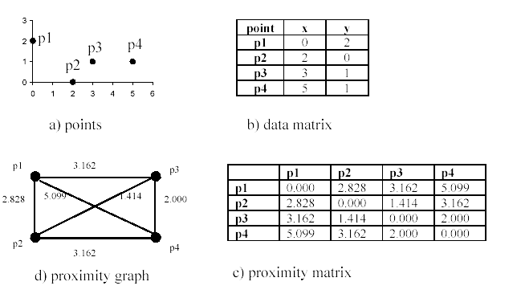
Distance measures for partitioning based clustering

Slide 73
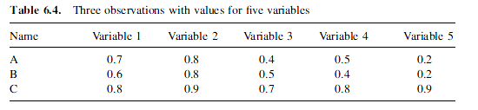
Data Matrix
Three observations
5 variables

Slide 74
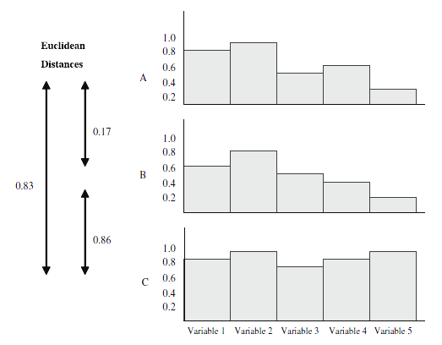
Distance between observations with 5 variables

Slide 76
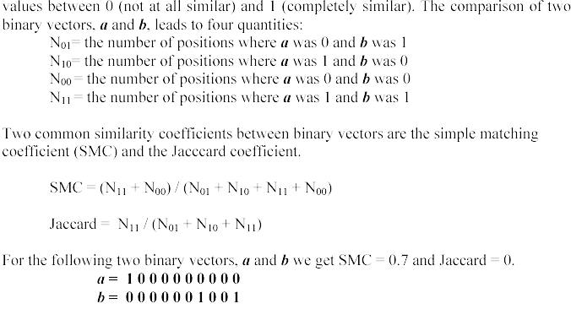
Similarity measures between binary vectors

Slide 77
Nominal Variables
A generalization of the binary variable in that it can take more than 2 states, e.g., red, yellow, blue, green
Method 1: Simple matching
m: # of matches, p: total # of variables
Method 2: use a large number of binary variables
creating a new binary variable for each of the M nominal states

Slide 78
Cosine Similarity
where ||x|| is the Euclidean norm of vector x
Conceptually, it is the length of the vector.
Computes the cosine of the angle between vectors x and y.
0 means that the two vectors are at 90 degrees to each other (orthogonal) and have no match.
Value close to 1, the smaller the angle and the greater the match between vectors.

Slide 79
Cosine Similarity Example

Slide 80
Case study 4- Amazon – recommender systems
Challenges
large retailer might have huge amounts of data, customers and catalog items.
Amazon.com has more than 29 million customers and several million catalog items.
results set to be returned in real time
New customers typically have extremely limited information or product ratings.
Older customers can have a glut of information,
Customer data is volatile
Item-to-Item Collaborative Filtering
scales to massive data sets and produces high-quality recommendations in real time
creates the expensive similar-items table offline
Rather than matching the user to similar customers, item-to-item collaborative filtering matches each of the user’s purchased and rated items to similar items, then combines those similar items into a recommendation list
This computation is very quick, depending only on the number of items the user purchased or rated.
Works better than search based or collaborative recommendation
Case study

Slide 81
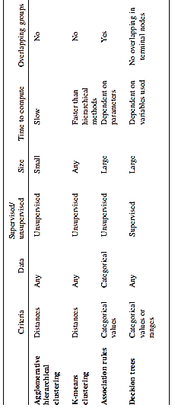
Summary of grouping methods

Slide 82
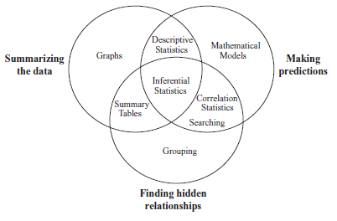
Introduction
is the science of examining raw data with the purpose of drawing conclusions about that information.
To make better business decisions
in the sciences to verify or disprove existing models or theories.
Consists of
exploratory data analysis (EDA)
confirmatory data analysis (CDA)
Qualitative data analysis (QDA)
Data Analysis tasks & methods

Slide 83
Introduction - Classification vs. Prediction
Classification
predicts categorical class labels (discrete or nominal)
classifies data (constructs a model) based on the training set and the values (class labels) in a classifying attribute and uses it in classifying new data
Ex – Class labels – buysComputer= “Yes” & “No”
Can result in a descriptive model and/or predictive model
Prediction
models continuous-valued functions, i.e., predicts unknown or missing values
Ex – predicting income on age & qualification
Typical applications
Credit approval
Target marketing
Medical diagnosis
Fraud detection

Slide 84
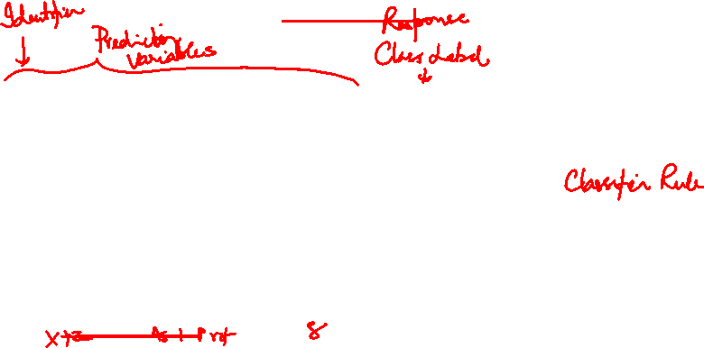
Phases in Classification Phase (1): Model Construction or Training Phase
Classification
Algorithms
Training
Data
Classifier
(Model)
IF rank = ‘professor’
OR years > 6
THEN tenured = ‘yes’

Slide 85
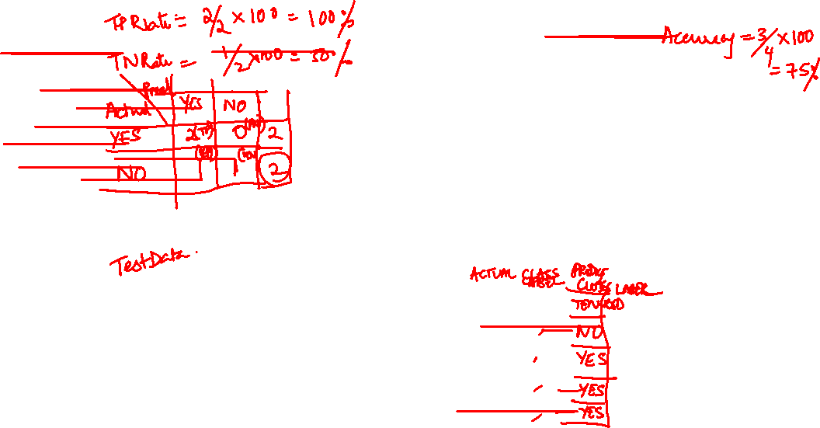
Phases in classification Phase (2): Using the Model in Prediction, Applying
Classifier
Testing
Data
Unseen Data
(Jeff, Professor, 4)
Tenured?

Slide 86
Supervised vs. Unsupervised Learning
Supervised learning (classification)
Supervision: The training data (observations, measurements, etc.) are accompanied by labels indicating the class of the observations
New data is classified based on the training set
Unsupervised learning (clustering)
The class labels of training data is unknown
Given a set of measurements, observations, etc. with the aim of establishing the existence of classes or clusters in the data

Slide 88
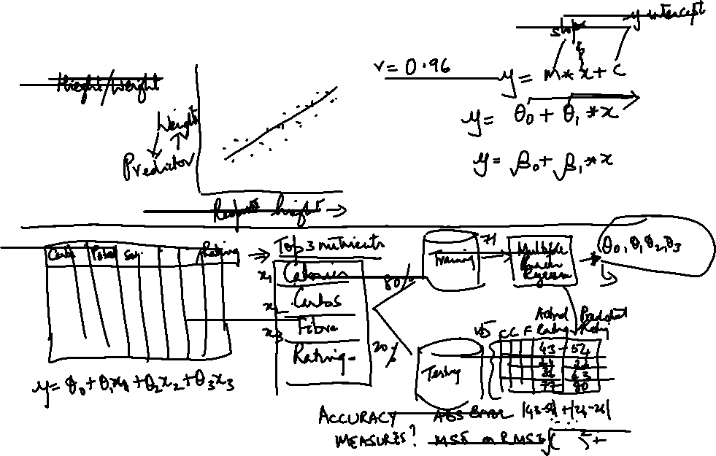
Multiple Linear Regression

Slide 89
References
Text book
Glenn J. Myatt, Making Sense of Data: A Practical Guide to Exploratory Data Analysis and Data Mining, John Wiley, November 2006.
References
I.H. Witten, E. Frank, M. A. Hall, Data Mining: Practical Machine Learning Tools and Techniques, Morgan Kaufmann, 2011
Pang-Ning Tan, Michael Steinbach, Vipin Kumar, Introduction to Data Mining, Pearson Addison Wesley, May, 2005.

